Slide 1
CHALLENGING FAMILIES
CREATE OPPORTUNITIES

Slide 2
The Art and Science of Working with Families
Triple P – Positive Parenting Program

Slide 3

There is no Magic Wand!

Slide 4
In a Nutshell Kathy Flores, San Lorenzo Unified School District
Positive communication with parents
Avoid making the child the problem
Identify the interests, concerns, needs, fears and desires of the parent
Look for options to meet those interests/goals
Be aware of legitimate limitations – socioeconomic (transportation, childcare), cultural, educational, mental, physical

Slide 5
In a Nutshell
Avoid be reactive
Maintain focus, calm, professional manner
Diffuse negative emotions – listen without judgment, restate their concerns, acknowledge feelings, find points to agree on.
Use good communication skills – tell me more, listen, keep tone positive
Engage in joint problem solving –focus on the problem (not the people), focus on strengths.

Slide 6
FRAMEWORKS/VALUE SYSTEMS
ACES
STRENTHENING FAMILIES – 5 PROTECTIVE FACTORS
TOUCHPOINTS
BRIDGES OUT OF POVERTY
CHANGE MANAGEMENT
TRAUMA INFORMED CARE

Slide 7
ADVERSE CHILDHOOD EXPERIENCES (ACES) EFFECT
Emotional States (depression, anxiety)
Behavior (drug and alcohol dependence, relationship problems)
Physical well-being (chronic disease)

Slide 8
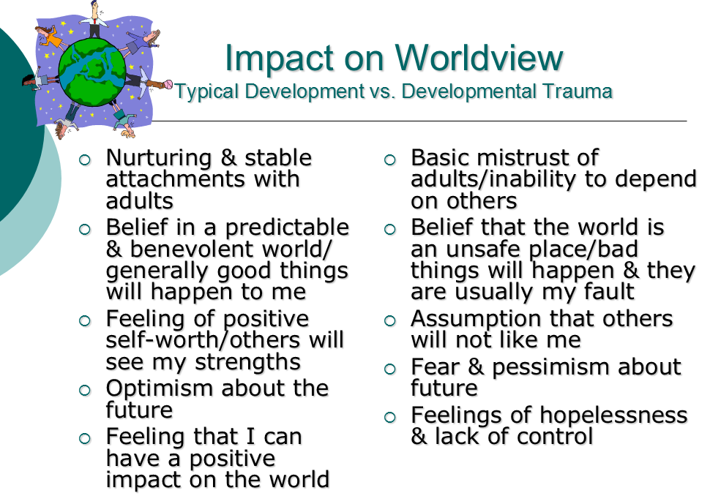

Slide 9
How do ACES Effect Parenting?
What is it like to live in a household with parenting adults who have depression, substance abuse issues, chronic illnesses?
How can we change outcomes for children by giving parents a chance to make a different meaning from their experiences?
Can we support parents in choosing a more protected developmental path for their children?

Slide 10
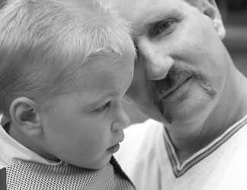
Strengthening Families Guiding Principles
All families have strengths
All families need support
Focus on protective factors that all families need

Slide 11
Protective Factor | Defined
Parental Resilience | The ability to cope and bounce back form all kinds of challenges
Social Connections | Friends, family, neighbors, and other members of a community who provide emotional support and concrete assistance to parents
Knowledge of Parenting and Child Development | Accurate information about raising young children and appropriate expectations for their behavior
Concrete Support in Times of Need | Financial security to cover day-to-day expenses and unexpected costs that come up from time to time, access to formal supports like TANF and Medicaid, and informal support form social networks
Social and Emotional Competence of Children | A child’s ability to interact positively with others and communicate his or her emotions effectively

Slide 12
TOUCHPOINTS – GUIDING PRINCIPLES
Recognize what you bring to the interaction
Look for opportunities to support mastery
Use the behavior of the child as your language
Value disorganization and vulnerability as an opportunity
Value and understand the relationship between you and the parent

Slide 13
TOUCHPOINTS – GUIDING PRINCIPLES
Be willing to discuss matters which go beyond your traditional role
Focus on relationships; parent/child, provider/parent
Value passion wherever you find it

Slide 14
TOUCHPOINTS – PARENT ASSUMPTIONS
The parent is the “expert” on his or her child
All parents have strengths
All parents want to do well by their child
All parents have something to share at each developmental stage
Parents have ambivalent feelings
Parenting is a process built on trial and error

Slide 15
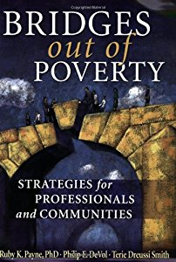
Bridges Out of Poverty
http://www.ahaprocess.com/
Ruby Payne

Slide 16
Social Class vs. Economic Class
Social Class is our judgment about how we are positioned compared to others.
Economic Class is about how stable our life is. Do we have resources and choices available to us to envision a positive future story?
We create mental models based on our circumstances.
Absolute poverty
Generational poverty
Situational poverty

Slide 17
HIDDEN RULES
Unspoken cues or habits of a group that let you know if you do or do not belong.
Hidden rules are about how well we navigate different situations and how we understand economic environments different from our own.
It is helpful to learn hidden rules in order to improve relationships, resolve conflicts, and design programs more skillfully.
Hidden rules come directly from the environment in which one lives. If one grows up in poverty, he or she will learn the hidden rules of poverty in order to survive.

Slide 18
 | Poverty | Middle Class | Wealth
Food | Did you have enough? Quantity | Did you like it? Quality | Was it presented well? Presentation
Driving Forces | Survival, Relationships Entertainment | Work and Achievement | Financial, Political and Social Connections
Time | Present most Important | Future most Important | History and Traditions Important
Destiny | Fate, Can’t do much to change | Belief in Choice | Noblesse oblige
Power | Linked to personal respect, ability to fight | Self-sufficiency, information Institutions | Expertise, connections, influence policy

Slide 19
Observations about hidden rules
People in poverty class can benefit by knowing the hidden rules of schools, work and community
People in the middle class can design programs better if they understand the environments and rules of the other classes
People in wealth who want to participate in building sustainable communities can by knowing hidden rules of others coming to the planning table.

Slide 20
Role of language and story
Hidden Rules
Middle Class: use formal register for negotiations, verbal, abstract and proactive skills are necessary.
Poverty Class: use casual register for survival.
Wealthy: use formal register for networking
Language and Power
Casual is more accurate
Formal has more power
Communication can be a balance of power problem
Listening is an attitude more than a skill

Slide 21
2 Gen Approach
Programs have to reach both children and parents.
Vicious Cycle
Unpredictable, low wage jobs, increased stress, less self-regulation, increased behavioral issues, decreased bandwidth and worse sense of self, ability to improve made more difficult.
Virtuous Cycle
Improved routines, decreased stress, better self-regulation, better behavior, increased bandwidth and improved sense of self, improved economic independence, improved outcome levels for all.

Slide 22
Strategies
Build relationships
Help with Language Issues
Help understand the rules (child welfare/schools etc.)
Analyze the resources and make interventions based on resources that are accessible
Teach mental model
Teach how to plan
Use adult voice and reframe to change behavior
Teach how to ask questions
Understand family dynamics

Slide 23
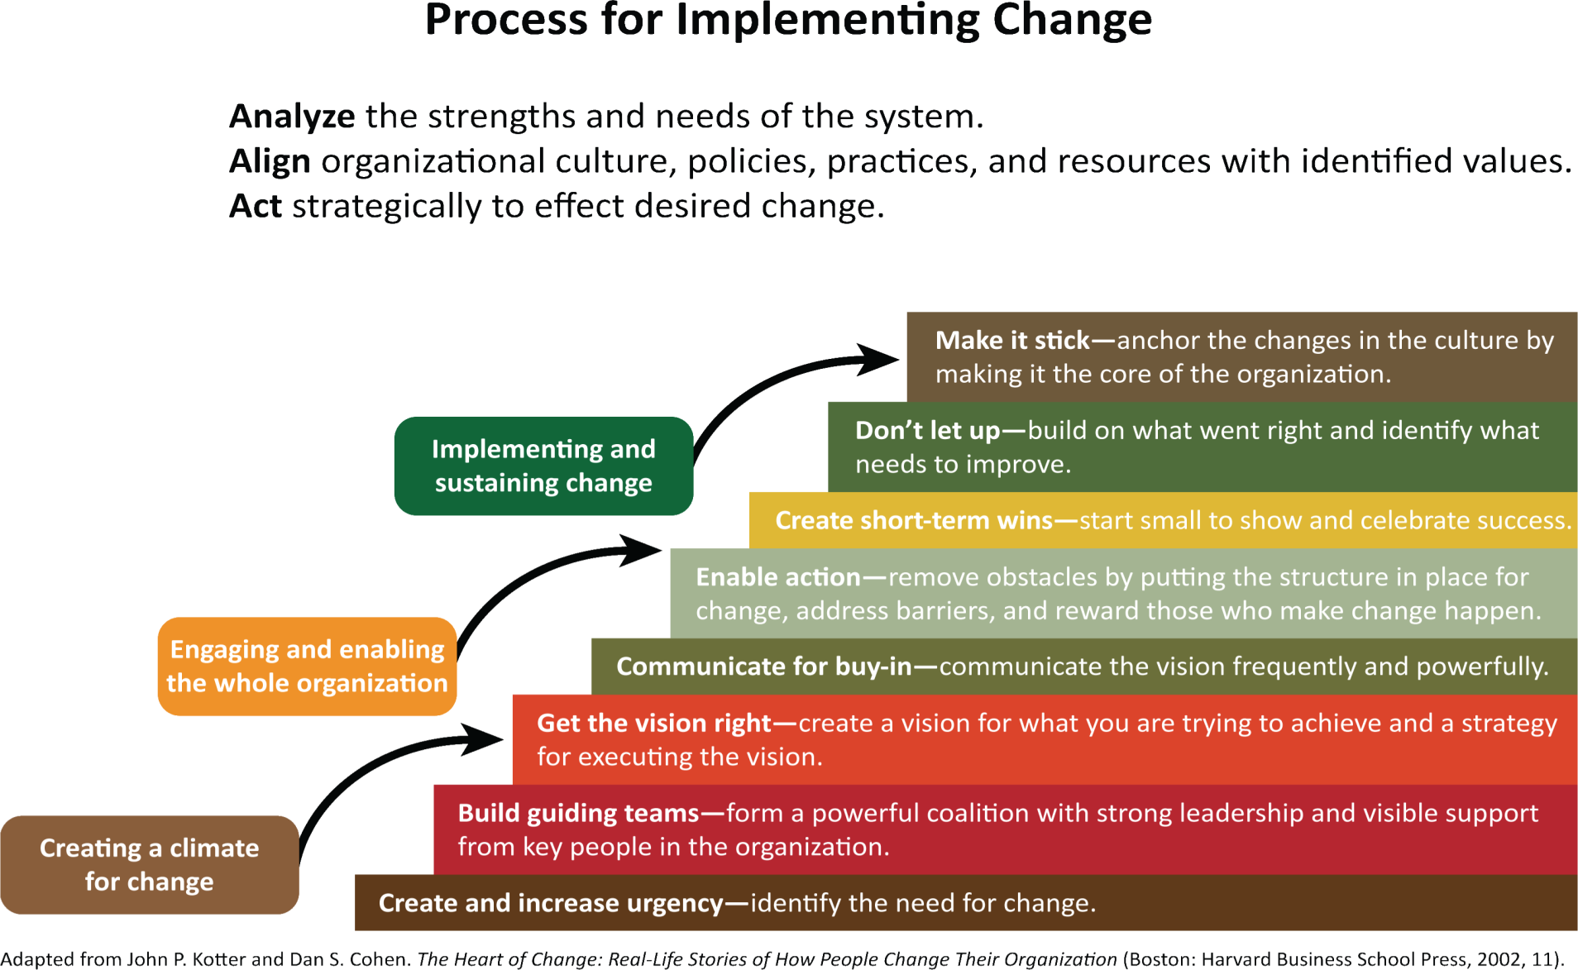
Process for Implementing Change

Slide 24
ADKAR - Change Management Model
Awareness of the need for change
Desire to participate and support the change
Knowledge of how to change
Ability to implement the
required skills/behaviors
Reinforcement to sustain the
change
Hiatt, J. (2006) ADKAR: a Model for Change in Business, Government and our Community : How to Implement Successful Change in our Personal Lives and Professional Careers. Change Management Learning Center, Prosci, CO.

Slide 25
TRAUMA INFORMED SERVICES
Recognize that reactive behavior “difficult people” can be an individual’s automatic attempt to deal with what they perceive to be a threating situation
Typically calm when provided with the perceived external containment and safety of clear structure(knowing what to expect) and clearly, respectfully, enforce limits & boundaries

Slide 26
Trauma Informed approach
Safety: Ensure physical and emotional safety of program families though out the system of care
Trustworthiness: Make tasks and expectations clear and maintain appropriate boundaries.
Transparency: The visual you can give of what your program can offer in the way of support

Slide 27
Trauma informed approach
Collaboration: Sharing of power with program participants
Mutuality: Sharing of learning
Empowerment: Providing skill building, and offering needed resources

Slide 28
FUNDAMENTALS OF HELPING RELATIONS – THE ART
Being present & attuned: the internal experience of the client and demonstrating you understand (active listening)
Asking for feedback: (collaboration) “please tell me what you think is very important that I understand” “What do you think about practicing that idea?”
Repairing a disrupted relationship: relationship got “off track” go back to step 1 (present and attuned) “ I understand this has been really challenging for you.”

Slide 29
Listening & Understanding
Traumatized and very stressed people may not be able to hear and understand you or the process until they experience that they are being understand by you.
Not necessarily agree with them, just that you understand what their experience is.
This step with a safe, structured environment usually helps upset people begin to “emotionally regulate” emotionally, physically, and behaviorally.

Slide 30
Working with traumatized people
Actively and reflectively listen until person feels understood.
Take more time and go slower, explain expectations and make sure they are understanding you correctly.
On occasion use summarizing statements
Authoritative tone of voice vs. Authoritarian tone of voice
Setting limits firmly and respectfully

Slide 31
Non-verbal cues
The initial reaction to trauma cues are in the right (non-verbal) brain, facial responses, vocal tone, body posture and movement.
If you notice something “ is there something I said I wasn’t clear about”

Slide 32
Putting Together the Art and Science

Slide 33
Triple P Positive Parenting Program Is Evidence-Based
Triple P as Prevention
Improves confidence and competence with parenting skills that promote social, emotional and behavioral competence in children
Reduces coercive family processes and use of punitive disciplinary practices that can lead to escalation of problems
Decreases parental depression, anxiety, stress and anger
Notes:
We know through the National Survey of Child Health (2011-12) that over 18,000 children in Sonoma County have 2+ ACES. Triple P is important because it serves as a mechanism for addressing ACES.
Pre-post intervention scores on common child behavior inventories demonstrate reductions below clinical thresholds for externalizing (i.e. ODD, ADHD) and there is evidence base for reducing internalizing (i.e. anxiety) as well.

Slide 34
Triple P Positive Parenting Program Is Evidence-Based
Triple P as Intervention
Can reduce externalizing behaviors (ADHD, ODD)
Helps with internalized disorders (anxiety, etc.
Interrupts the negative behavioral cascade that causes families to utilize more community resources
Notes:
We know through the National Survey of Child Health (2011-12) that over 18,000 children in Sonoma County have 2+ ACES. Triple P is important because it serves as a mechanism for addressing ACES.
Pre-post intervention scores on common child behavior inventories demonstrate reductions below clinical thresholds for externalizing (i.e. ODD, ADHD) and there is evidence base for reducing internalizing (i.e. anxiety) as well.

Slide 35
Triple P Promotes Parental Self-Regulation
Personal Agency
Change is attributed to parent’s or child’s efforts
Problem-Solving/Generalization of Skills
Ability to apply skills/knowledge to new situations
Notes:
This model allows Triple P to be culturally relevant in different contexts and increases parental commitment to interventions (parents choose parenting goals based on own culture, values, beliefs). Validates parents’ experiences.

Slide 36

Matt Sanders
It is a community’s responsibility to value and support the importance of raising children.
Self-regulation applies to parents, children, practitioners, agencies.
Triple P is a trauma sensitive intervention
“The most important thing in dealing with trauma is that it ceases”

Slide 37
Aspects of Positive Parenting
In addition to the 5 core principles:
Supporting children’s relationship with peers
Balancing work and family responsibility (transitions)
Effective communication with teachers
Maintaining a positive relationship with extended family
Being part of a community.

Slide 38
What Drives Change in Parents
Cognitive Change – attributions, expectations, knowledge, self-efficacy
Behavioral Change – praise, incidental teaching
Affective Change – control of emotions, increase positive affection
Contextual Changes – support in different environments

Slide 39
Parent Engagement
Normalize Participation – peer to peer, social contagion.
Target normative transitions – to childcare, school transitions.
Increase consumer engagement – focus groups, incentives.
Keep things really simple, practical and friendly.

Slide 40
Grace Harris, MFT
Parent Resources Director
Child Parent Institute
graceh@calparents.org
(707) 585-6108 x 1103

