Slide 1
The Power of Parenting
Andrew Pari, L.C.S.W., Diplomate
&
Allison Mupas, L.M.F.T.

Slide 2
How behavior is created & changed
All living things respond to their environment.
Animals, from the very simple to the more complex (humans), respond to stimulation.
This can be positive (aka rewarding) or negative (aka painful).
Positive will lead to more of a behavior. Pain will lead to less. This is true of all creatures.
And children are no different!

Slide 3
How behavior is created & changed
Love, nurturing, praise, attention, pleasure and positive reactions will typically lead to more of a behavior.
Pain, neglect, ignoring…will typically lead to less of that behavior.
Pleasure is a far more effective way to increase & improve behavior than pain or punishment.
Studies of the brain show that love/talk/play interaction with children reduces certain stress toxins that cause irritability and lead to problem behavior.
So, does punishment ever work?

Slide 4
Discipline
NO! Physical discipline (spanking, whuppin, hitting, slapping, beating, etc.) does NOT permanently change behavior, but it DOES increases anger and depression.
Fact: studies have demonstrated for decades that physical punishment does little to correct or change a specific behavior.
Fact: recent studies show that spanking reduces the intellectual development of a child, resulting in reduced learning and reasoning ability.

Slide 5
Discipline
What about verbal discipline such as yelling, shouting, insulting, demeaning? Nope.
The definite pleasure of a given behavior will always win out over the potential pain of a consequence.
In fact, external negative reaction can often INCREASE an unwanted behavior.
Problem behavior makes unhappy parents, friends, teachers and neighborhoods. Who is unhappiest of all: your child!
So, great. What do I do then?

Slide 6
Getting the behavior you want
Parents/caregivers are the most positive influence to shape, mentor and guide a child’s behavior and development. You rule!
Therapist can work with your child for 1-hr/wk.
YOU are with your child 168 hrs/wk!
Gaining or restoring harmony, peace, love and FUN in your family is the ultimate goal.
“Close friends and family” is the most important source of a kid’s happiness.
How do we do this? (video: http://www.triplep-america.com/glo-en/see-and-hear/watch-videos/the-triple-p-system-explained/)

Slide 7
Introduction to Triple P
Positive Parenting Program
10 week group oriented skills-focused course led by professionally trained psychotherapists.
Internationally practiced in multiple languages, researched for over 30 years with tens of thousands of families.
Triple P takes the best practices we know about parenting and puts them into one package.
Often parents find that they have the same problems as others and didn’t know it. They may feel alone or ashamed. The group setting lets you share your difficulties with other parents who are in the same boat.

Slide 8
Five levels of Triple P
Level 1: Media-based public campaign.
Level 2: Brief health provider strategy.
Level 3: Narrow focus seminars.
Level 4: Professionally-provided parenting skill-building.
Level 5: Intensive family intervention for systemic family problems or potential abuse.

Slide 9
How does Triple P Work?
Key Points
Ensure a safe, engaging environment.
Creating a positive learning environment.
Using assertive discipline. Neither passive nor aggressive!
Having realistic expectations.
Taking care of yourself.

Slide 10
How does Triple P Work?
Overview of the Program
Finds out your style of parenting and your child’s primary behavioral needs.
Focus on building positive response from the child by providing parents with specific, effective methods that promote positive behavior.
Combination of learning developmental patterns, skill building, discussion, role-play and telephone consultation.
Supported by video demonstration, books and supervised practice to ensure you understand and can implement the techniques you learn.
Childcare is available.
There’s also a website & completion certificate!

Slide 11
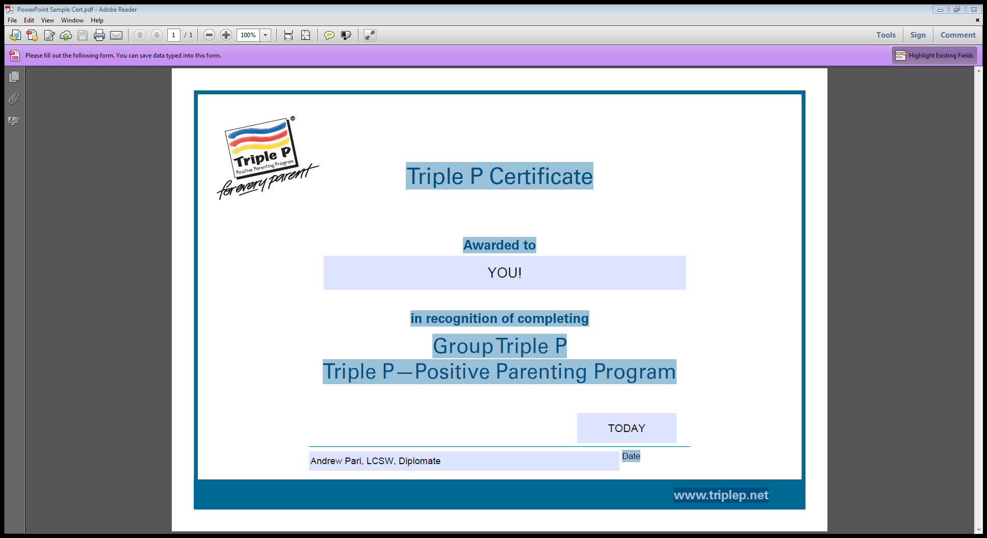

Slide 12
How does Triple P Work?
What will you learn?
Discipline that emphasizes guidance/teaching over punishment.
Reducing emotional over-reaction/under-reaction to child’s behavior.
Creating/restoring a strong, positive bond between parent and child.
How to handle difficult situations: tantrums in public, playing well with friends, following directions and more!
You get to practice new skills so that you feel confident when you try them with your child.

Slide 13
How does Triple P Work?
How will I learn this?
Each week focuses on a different aspect of child behavior and how to address it.
Role-playing with the group leaders and members to practice new skills.
Opportunity to talk about what worked and what didn’t in a supportive, accepting place, and do more practice to improve.
Practice makes progress!

Slide 14
Quotes from Parents who Completed Triple P
“I didn’t believe it would work at first, but was really surprised after just a few weeks to see how my son was doing.”
“She turned it around in a couple months. She’s been like this for years.”
“If I can do this, so can you!”

Slide 15
Results of Triple P
30% of parents completing Triple P saw a resolution of their child’s behavior problems.
Most will see significant improvement.
Did you know that being rich only adds 3.5% happiness and satisfaction to your life?
Do the math!

Slide 16




The Power of Parenting
It begins with YOU!
Q&A

