Slide 1


Triple P: Coming to a Doctor's Office Near You?
Primary Care Triple P in the State of Washington
December 4, 2013
Scott Waller, M.Ed., CPP
Prevention Integration Lead, Washington State Division of Behavioral Health and Recovery

Slide 2
Washington State Triple P Project
DBHR/SCH/UW Primary Care Communities Project
  More than 20 healthcare providers including 7 who can bill Medicaid (M.D., ARNP, PA)
  3 Rural communities

Slide 3
Project Objectives and Outcomes
Dissemination of a brief parent education consultation model to primary care providers
Determining how to scale up community capacity across the state
Facilitating community buy-in and community readiness
Identifying barriers to adoption
Facilitating reimbursement mechanism for primary care providers
Determining clinical outcomes and utilization benefits from the service

Slide 4
High priority – Get primary care providers involved
WHY?
Parents listen to primary healthcare providers – even if they do not always follow the recommendations.
Affordable Care Act and Healthcare Homes – primary care providers can influence trajectory of problems through appropriately timed interventions.
Interested in well-being of patients.

Slide 5
Barriers for primary care providers
Time – for meetings, for training, for delivery of services, for record-keeping, etc.
Medical practices are businesses – there is little room in the course of a day for non-billable services.

Slide 6
Keys to setting up Medicaid billing
State Medicaid medical director – impact of Triple P in reducing child harm indicators in South Carolina
Mental health DSM codes – identify those that would likely show up in primary care provider office, e.g., sleep disorders
Referral protocols - for patients who need more intensive behavioral health support than primary care providers can offer

Slide 7
Keys to setting up Medicaid billing
Current Procedural Terminology (CPT) billing codes – identify appropriate codes for variances in time, initial vs. ongoing services
System understanding of billing process

Slide 8
Billing process in Washington
Provider One (Washington’s Medicaid Billing system) – primary care providers participating in this project bill for Triple P services using specific authorization codes through centralized billing system

Slide 9
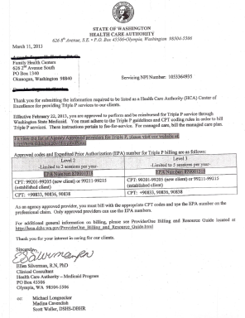
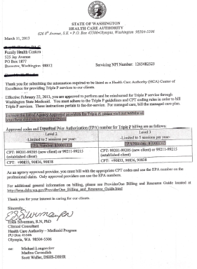
Keys to setting up Medicaid billing
Tie billing to Triple P certification - after training they get provisional billing authority; certification necessary to retain

Slide 10
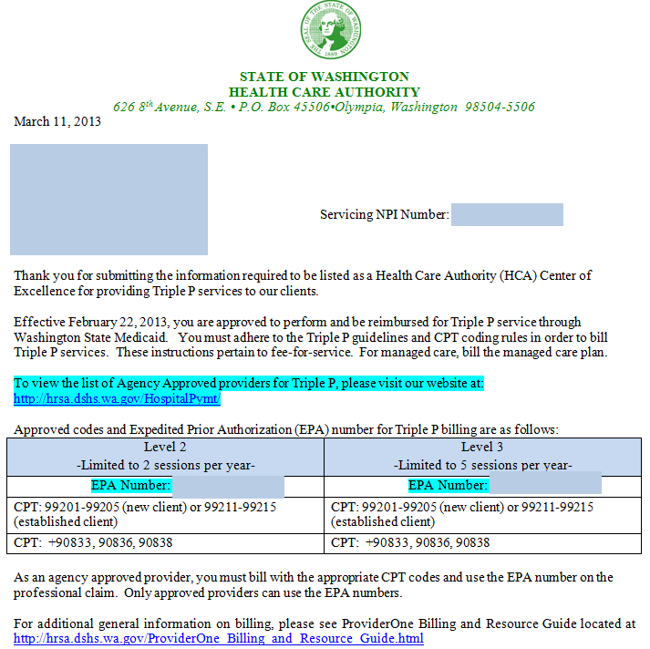
Sample authorization letter

Slide 11
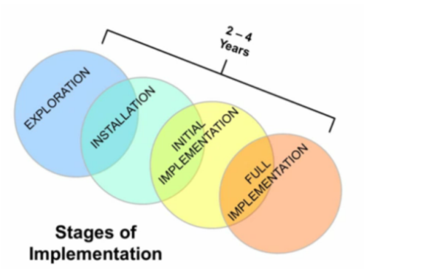
Using Implementation Science Research
Reducing the gap between what is known to be effective and what is provided to consumers in community practice setting.
How do you change the behavior of well-meaning human service providers?
K.Blasé
Fixsen & Blasé, National Implementation Research Network
http://www.fpg.unc.edu

Slide 12
Core Implementation Components
Selection
Pre-service training
Consultation and Coaching
Facilitative Admin Support
Staff and Program Evaluation
Fixsen, DL, et al. (2005). Implementation Research: A synthesis of the Literature. Tampa, FL: University of South Florida, Louis de la Parte Florida Mental Health Institute, The National Implementation Research Network (FMHI Publication #231).

Slide 13
Next Steps
Program evaluation
Program expansion
  Regional mental health networks
  Other primary care providers
Collaboration with parallel Triple P projects
Public health media campaign
Statewide coordination of entire Triple P system of care

Slide 14
For more information
Scott Waller, M.Ed., CPP
Prevention Integration Lead
Washington State Division of Behavioral Health and Recovery
360 725-3782 | scott.waller@dshs.wa.gov

